Slide 1
Lightweight assistive technology: A wearable, optical-fiber gesture recognition system
Sanjay Seshan

Slide 2
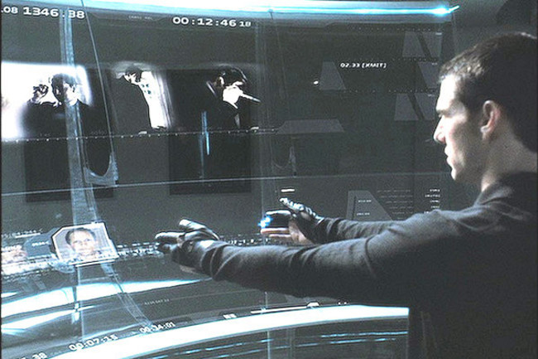
Vision
A lightweight way to interact with computers around us
Allow the computer to recognize a wide range of hand gestures
Don’t want to require the use special gloves or other intrusive hardware
Notes:
Minority report

Slide 3
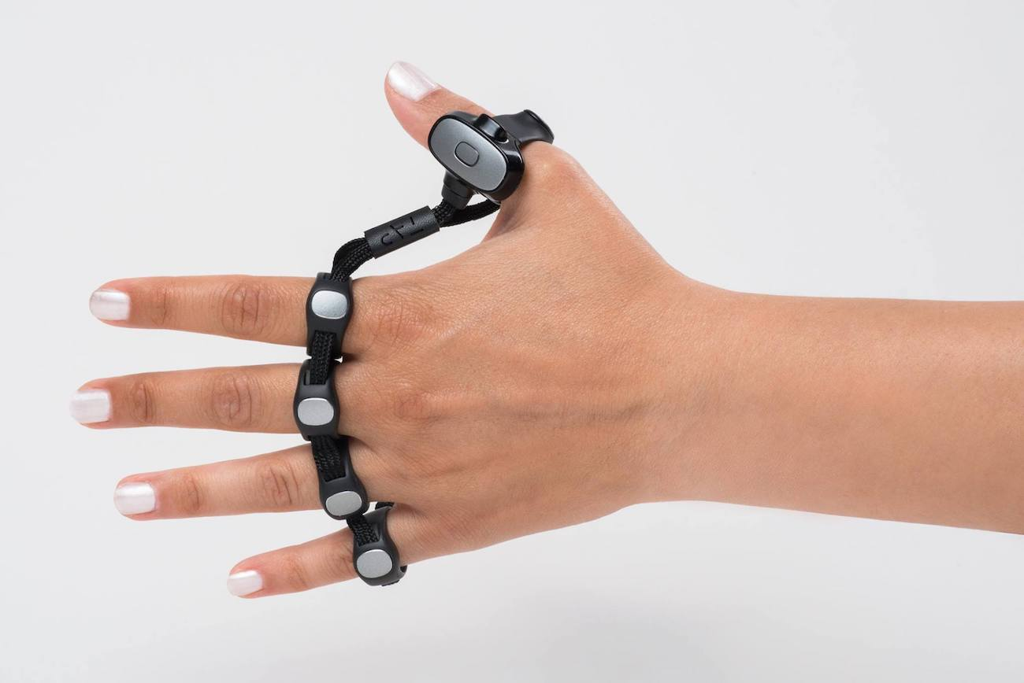
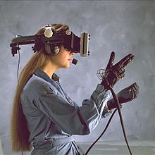
State of the ART
Current methods are intrusive
Tap
Wired glove Radar
Cameras and OpenCV
Limitations: accessibility, intrusiveness (a glove or rings are much more intrusive than a watch) price (radar), and feasibility (camera must be facing you – i.e. not wearable)
Notes:
https://en.wikipedia.org/wiki/Wired_glove
https://www.youtube.com/watch?reload=9&v=mpbWQbkl8_g#t=810
https://towardsdatascience.com/training-a-neural-network-to-detect-gestures-with-opencv-in-python-e09b0a12bdf1

Slide 4
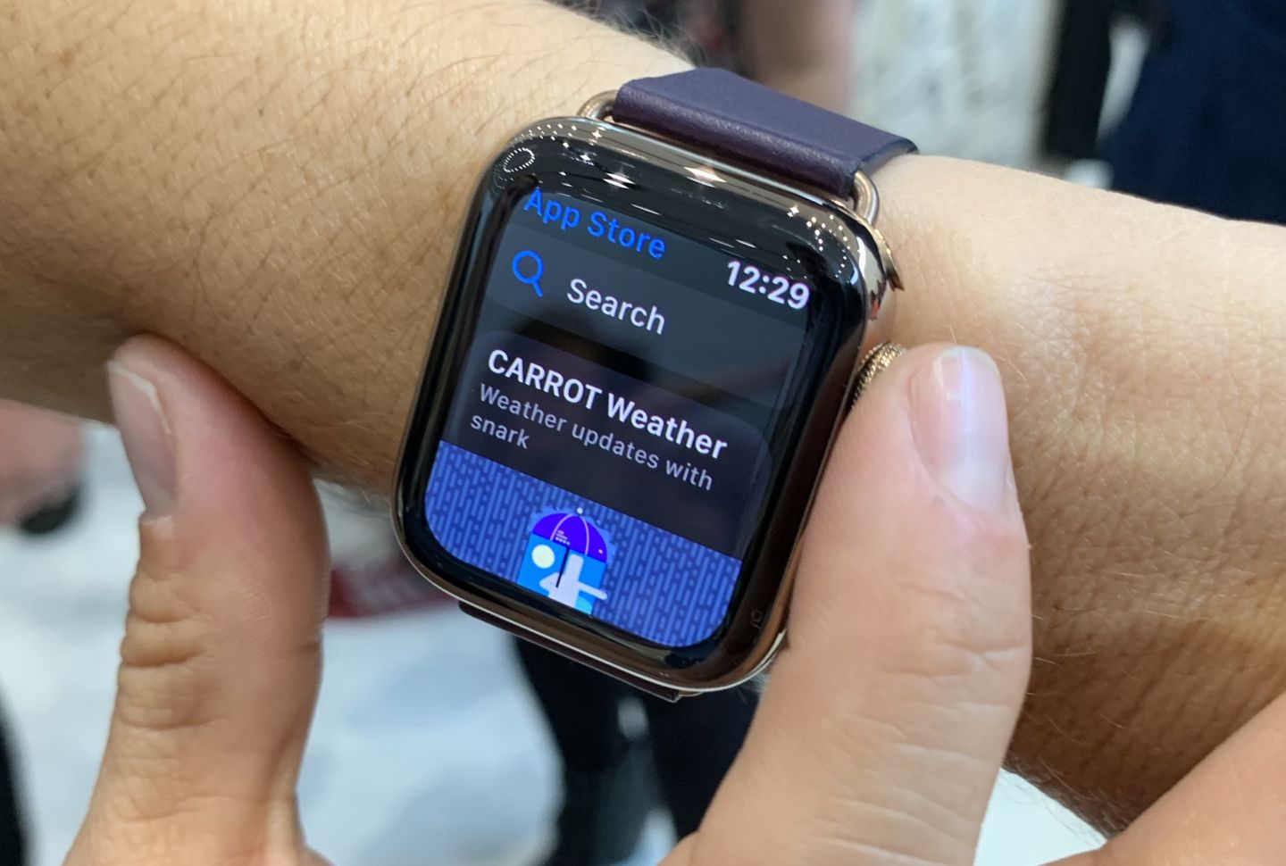
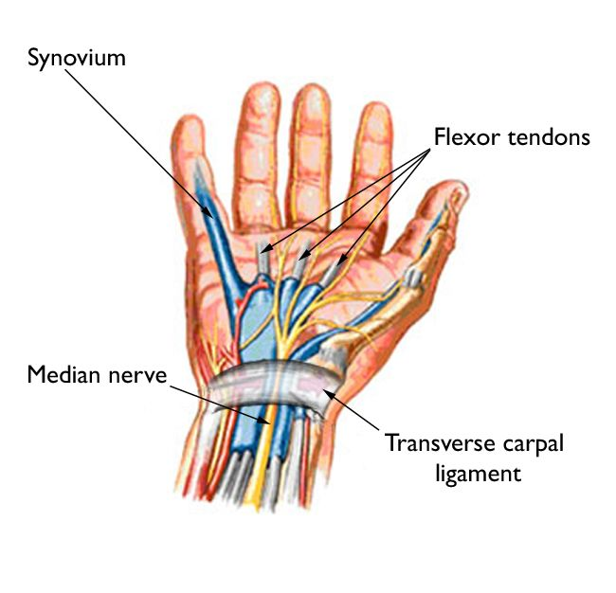
Basic idea
Can we identify gestures from a watch strap?
1 in 6 adults own a smart watch
Transverse carpal ligament area
Deflection occurs when fingers [tendons] are moved
Magnitude of deflection of different tendons can be used to identify gestures
6 different tendons in wrist
How to measure deflection accurately?
Must measure all tendons and measure tiny (< 1 mm) movement
Deploy a set of sensors across a watch strap
Notes:
https://www.extremetech.com/mobile/285724-1-in-6-us-adults-now-own-a-smartwatch
https://arstechnica.com/gadgets/2019/09/apple-watch-series-5-hands-on-software-is-king/

Slide 5
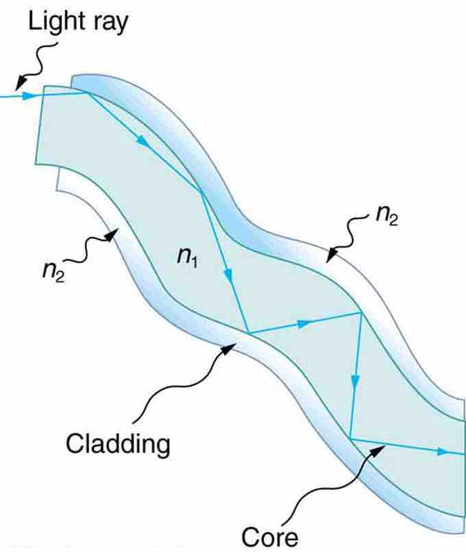
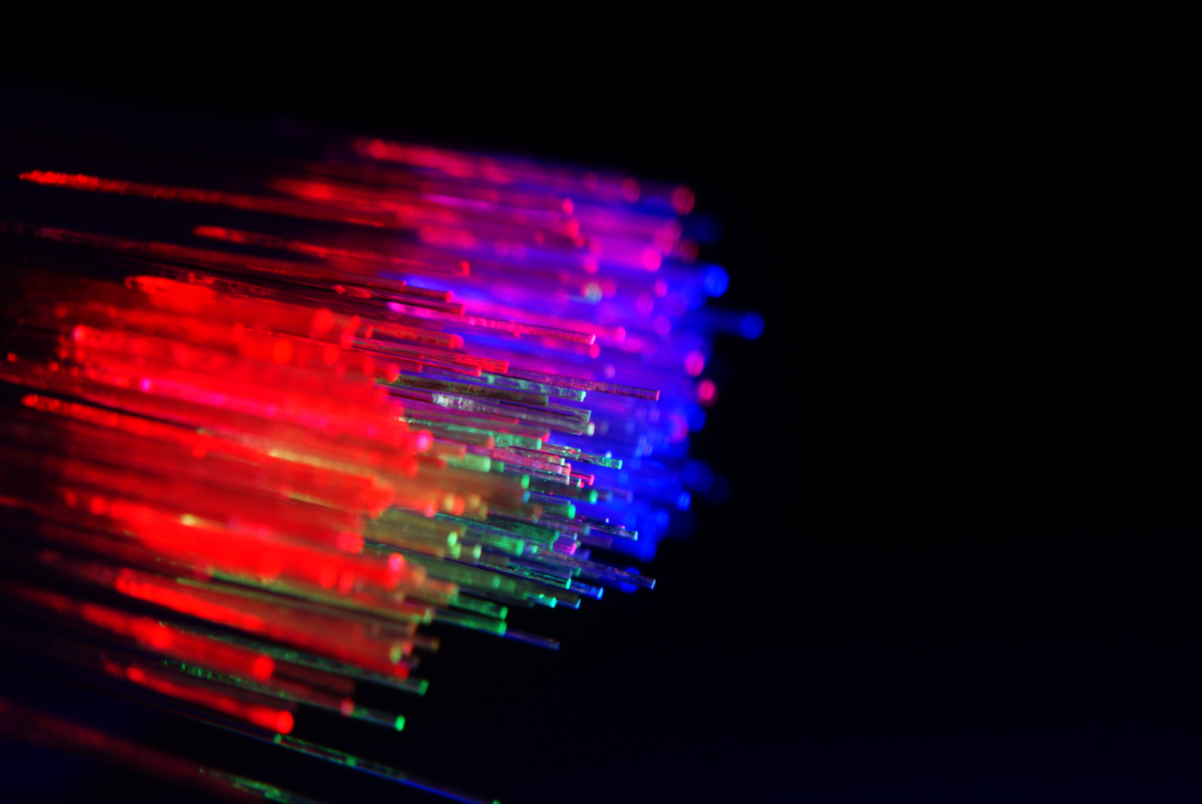
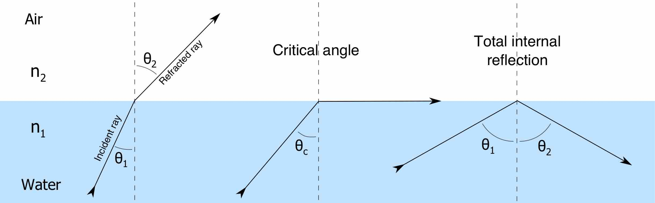
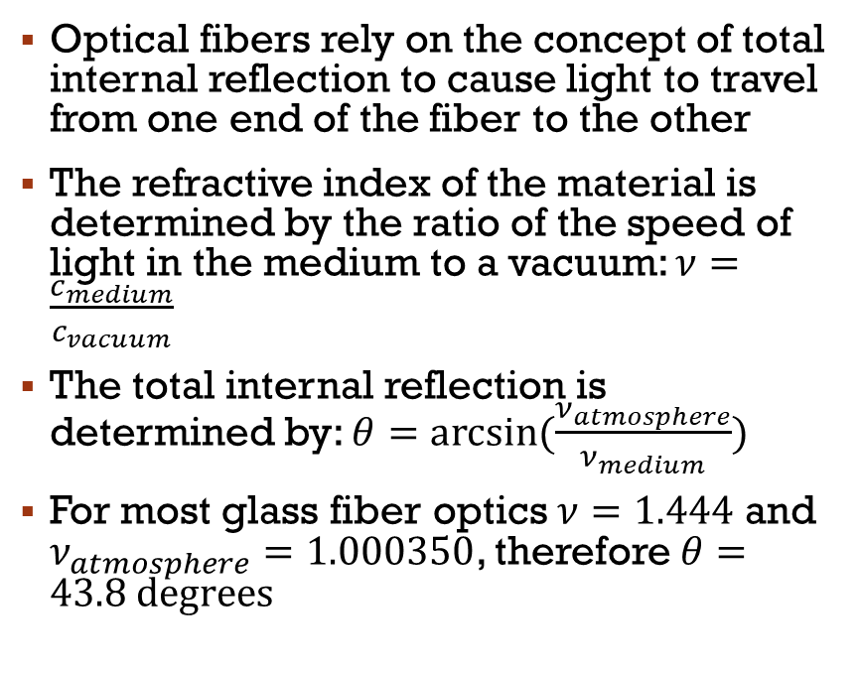
Optical Fibers as Sensors (1)
Optical fibers rely on the concept of total internal reflection to cause light to travel from one end of the fiber to the other
The refractive index of the material is determined by the ratio of the speed of light in the medium to a vacuum: $ν=\frac{c_{medium}}{c_{vacuum}}$
The total internal reflection is determined by: $θ=arcsin(\frac{ν_{atmosphere}}{ν_{medium}})$
For most glass fiber optics $ν=1.444$ and $ν_{atmosphere}=1.000350$, therefore $θ=43.8 degrees$
Notes:
https://www.flickr.com/photos/brixendk/4349817216
Note that $ν_{atmosphere}=1.000350$, which is almost the same as a vacuum ($ν_{vacuum}=1$), so $θ≈arcsin\left(\frac{1}{ν_{medium}}\right)$

Slide 6
Optical Fibers as Sensors (2)
If light strikes the fiber-atmosphere boundary at less than the critical angle it is completely reflected
Imperfections and rough surfaces within the fiber can cause light to be scattered and lost
This loss is made worse when the fiber is bent or deflected
If fibers were embedded in a wrist strap, deflection due to hand movement would cause characteristic changes in the amount of light transmitted
Analyzing the transmitted light levels could allow computers to reconstruct gestures!
“Lost” Light
“Transmitted” Light

Slide 7
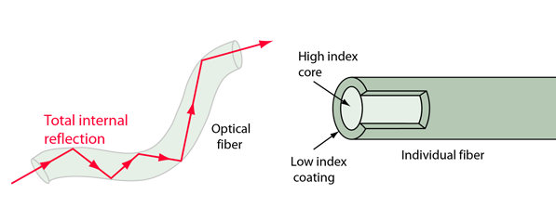
Fiber optics
This is ideally less than the critical angle allowing light to be lost.
The refractive index of these materials cannot be measured without special equipment, but it can be used to understand the loss of light in the fiber
In my setup the cladding is simply Earth’s atmosphere

Slide 8
Basic setup for Deflection Sensor
LED
Fiber/light medium
Photoresistor / Light Dependent Resistor (LDR)
Photoresistor/LDR
In order to detect the deflection using a LDR, a significant amount of light must be lost when the fiber is bent
35mm fiber length was determined to be the minimum for a noticeable light deflection when bent
LED

Slide 9
Key Questions
Pre Test
What type of fiber material would work well?
Must have imperfections that cause light loss due to deflection
Must have consistent, reproduceable behavior
What type of light should be transmitted?
The LDR sensors work best with different light colors/wavelengths
What shape of fibers work best?
Full prototype tests
How are light levels impacted by different gestures?
Can we uniquely identify different gestures using this approach?

Slide 10
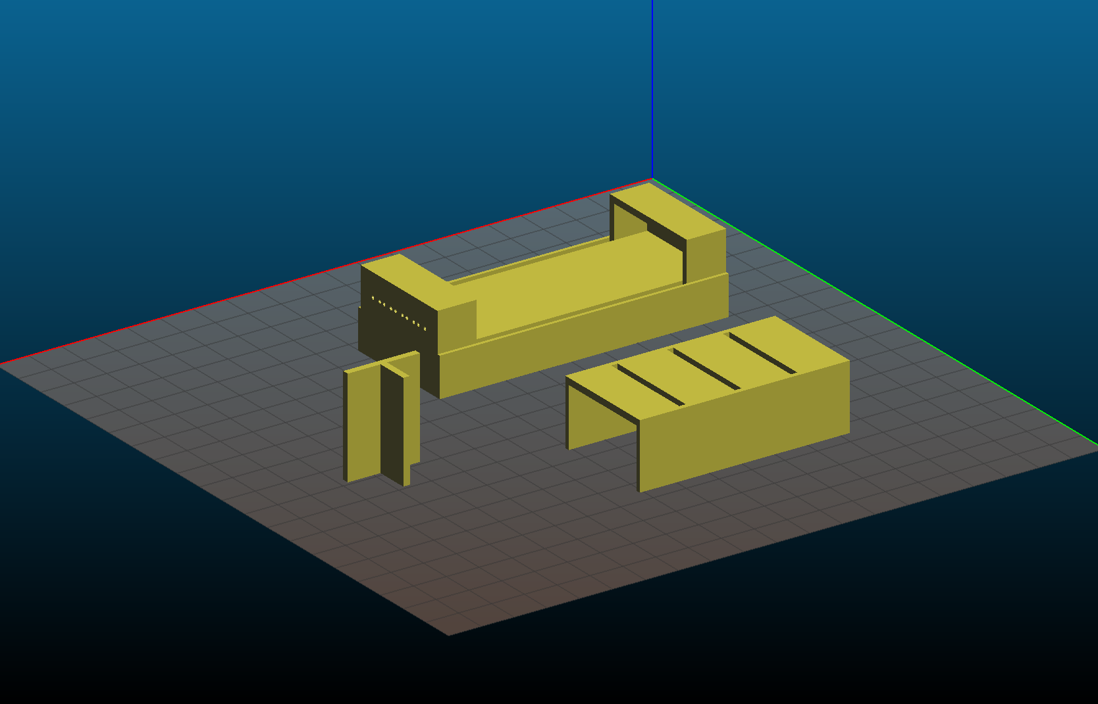
Testing process xxx unclear
Consistent 3d printed to isolate light
Holder for LED and LDR on each end
Plastic piece for consistent depression of medium

Slide 11
LED Color xxx makes no sense
Colour | Medium | Minimum Intensity | Maximum Intensity | delta Intensity
Large blue | Humimic #2 | 160 | 990 | 830
Large red | Humimic #2 | 183 | 1013 | 830
Large white | Humimic #2 | 205 | 1021 | 816
Small red | Humimic #2 | 180 | 977 | 797
Large red | Earth's atmosphere | 235 | 996 | 761
Large yellow | Humimic #2 | 210 | 971 | 761
Small green | Humimic #2 | 189 | 937 | 748
Large blue | Earth's atmosphere | 228 | 957 | 729
Large green | Humimic #2 | 185 | 850 | 665
Small red | Earth's atmosphere | 245 | 864 | 619
Small green | Earth's atmosphere | 253 | 775 | 522
Large green | Earth's atmosphere | 240 | 720 | 480
The optimal wavelength of the LDR must be determined
This does not depend on the material used
Humimic was used as a constant baseline due to its transparency
A 3d printed cast was used to eliminate external light
A constant depression was used to determine minimum intensity
Large red (630nm) and large blue (460nm) LEDs were determined to be the best. Red was chosen due to availability.

Slide 12
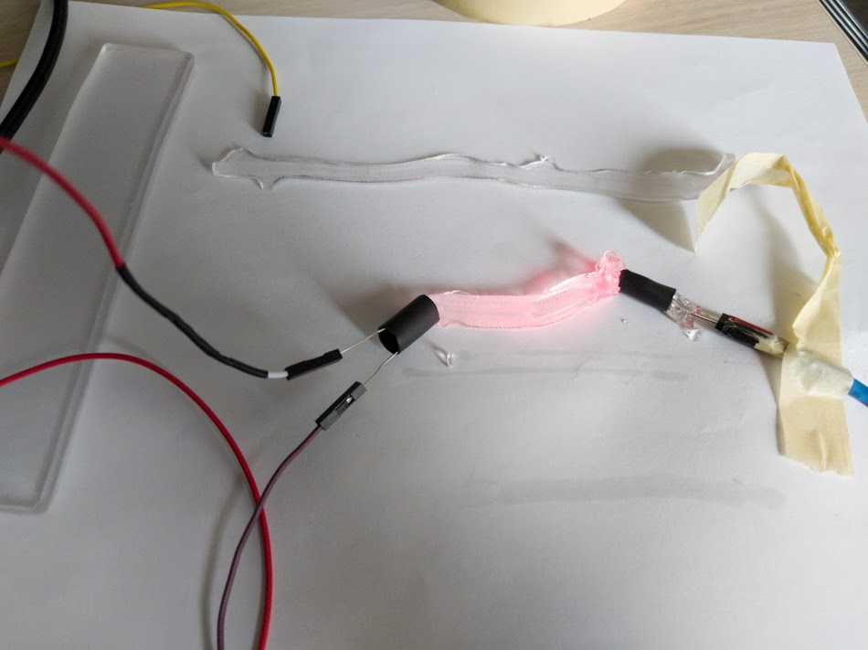
Materials/Mediums proposed
Standard optical fiber
Vytaflex – a semi-transparent urethane rubber
Ecoflex – an opaque silicone
Humimic gel – a transparent synthetic gelatin
Xxx why these 4?

Slide 13
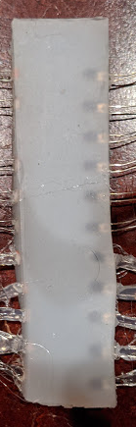
Problems with each material
Optic fibers were too perfect and there was no light deflection, even when bent over 90 degrees.
The internal reflection is too high
A non-ideal optical fiber is needed so that light is lost when bent
Ecoflex was too opaque and did not permit any light from the LED to pass
Humimic was too soft and melted/tore due to the body heat.
Humimic melts at about 50 degrees; body heat is about 40
XXX what worked and how well…

Slide 14
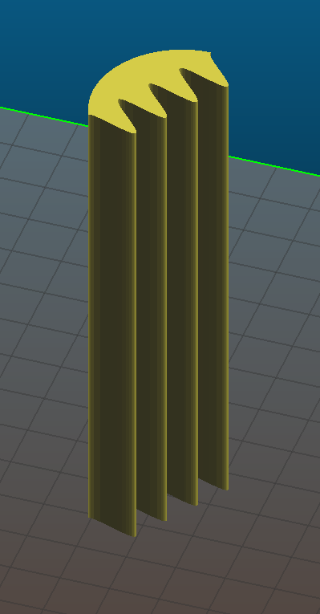
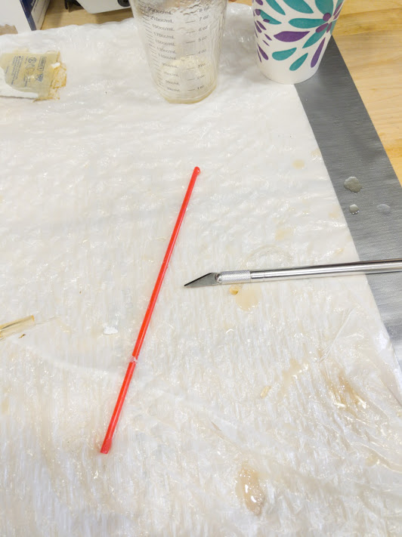
Different shapes tested
Tube
Shrink tube: 20mm, 5mm, 4mm
3d print: 2mm, 4mm, 5mm
Straws: 3mm, 5mm
Sinusoidal → manufactured by first casting a mold using Vytaflex (Silicone)
Rectangular
Minimize the diameter to keep multiple strands for higher resolution
Sinusoidal and Rectangular molds required sensors to be embedded = fragility
Shrink tube and 3d printed molds caused capillary action (the material stuck to the sides)
Straws proved to be the best mold – 3mm proved to be best for LED shape and resolution

Slide 15
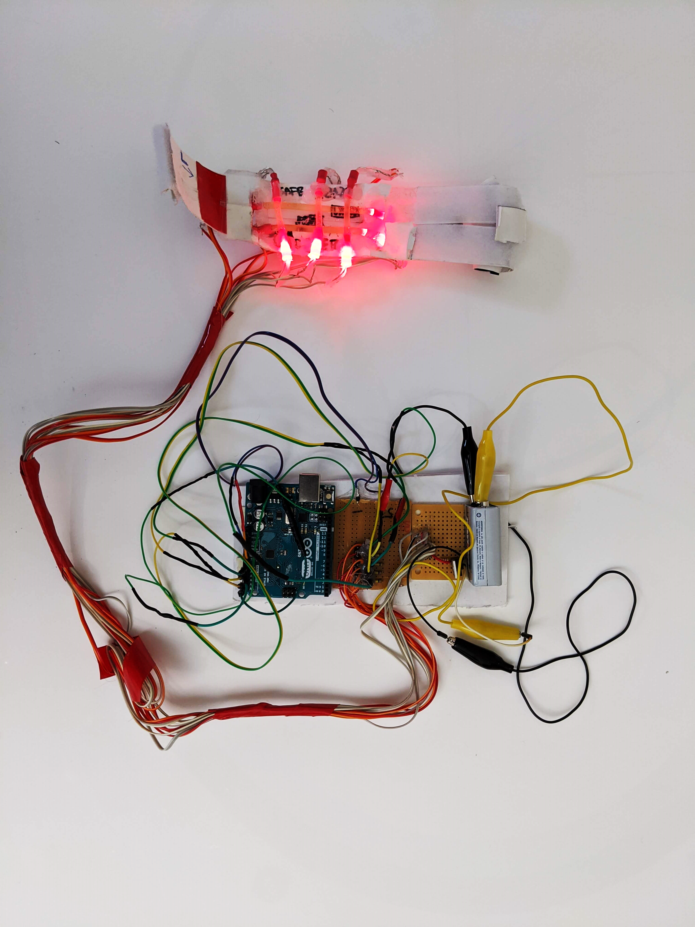
Final prototype
Measure left to right and up and down on hand
35mm fibers vertically and 80mm horizontally
LEDs and LDRs are fastened using heat shrink to the fiber

Slide 16
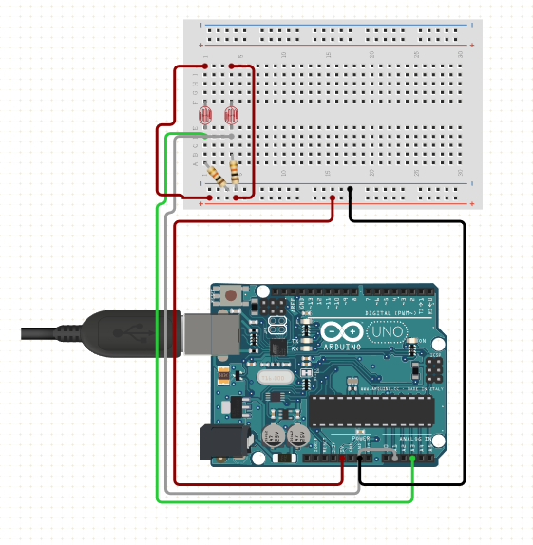
Collecting data
1 Arduino Uno
5 LDRs and 5 72.5k Ohm resistors
LED circuit:
9V battery, 5V regulator, 50 ohm resistor, 100 ohm resistor, Ohms resistors, 5 LEDs

Slide 17
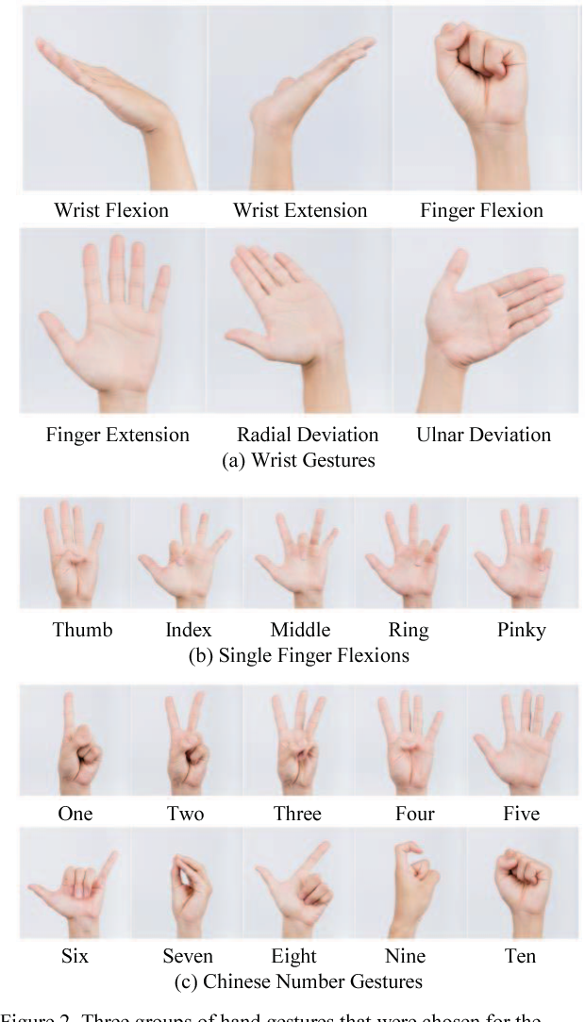
Gestures tested
Finger Extension [Extend]
Finger Flexion [Fist]
One

Slide 18
Sample data: one

Slide 19
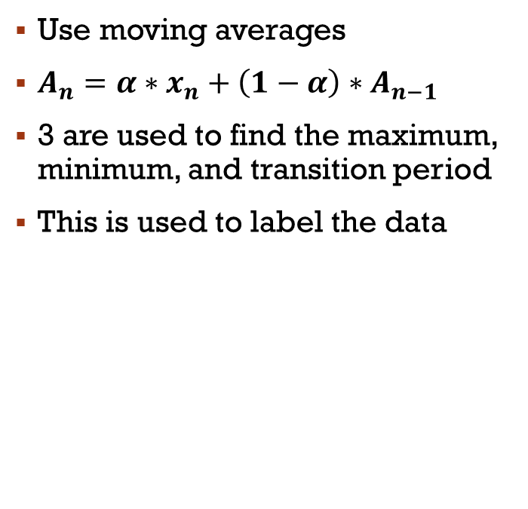
Determining hand position
Use moving averages
$A_{n}=α∗x_{n}+\left(1−α\right)∗A_{n−1}$
3 are used to find the maximum, minimum, and transition period
This is used to label the data

Slide 20
Labelling the data
Compare individual moving averages to original
Time of determined maximum
Time of determined transition
Time of determined minimum

Slide 21
Sample Data: Extend

Slide 22
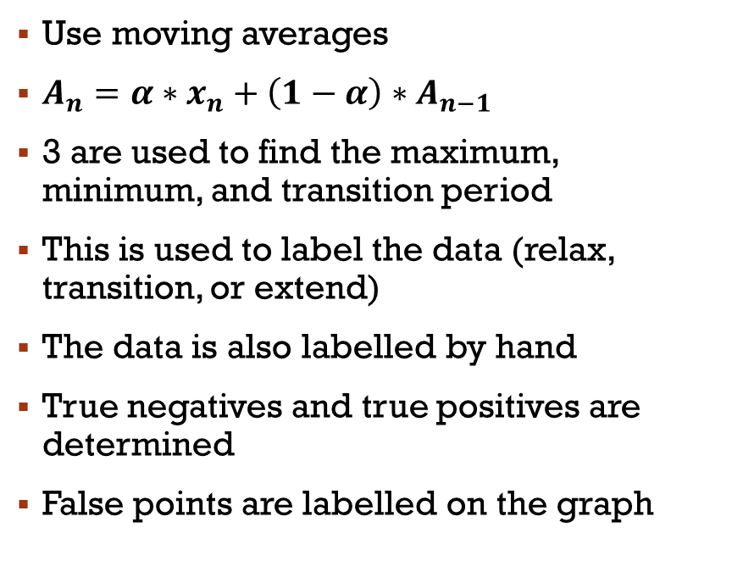
Labelling the data
Use moving averages
$A_{n}=α∗x_{n}+\left(1−α\right)∗A_{n−1}$
3 are used to find the maximum, minimum, and transition period
This is used to label the data (relax, transition, or extend)
The data is also labelled by hand
True negatives and true positives are determined
False points are labelled on the graph

Slide 23
conclusion

Slide 24
Code
Python data collector:
#!/usr/bin/python
import serial
import time
import sys
# Determine the file to save data to and Arduino port
fileOut = sys.argv[2]
port = sys.argv[1]
f = open(fileOut, "w")
# Open Arduino serial
ser = serial.Serial(port, 9600, timeout=1)
def getData(timeout, label):
# measure delta time of a single gesture cycle for timeout
timeI = time.time()
while time.time()-timeI < timeout:
try:
reading = ser.readline() # Read sensor values from Arduino
# Record delta Time, Unix time, ldr readings, and label to a file
data = [0,0,0,0,0,0,0,""]
data[0] = time.time()-timeIA
data[1] = time.time()
data[2] = int(reading.split('\n')[0].split(",")[0])
data[3] = int(reading.split('\n')[0].split(",")[1])
data[4] = int(reading.split('\n')[0].split(",")[2])
data[5] = int(reading.split('\n')[0].split(",")[3])
data[6] = int(reading.split('\n')[0].split(",")[4])
data[7] = label
for i in data:
print str(i)+",",
f.write(str(i)+",")
print ""
f.write("\n")
except:
pass
gestures = ["extend","fist","one"]*2 # declare labels of which gestrues are being tested
print("delta Time, Unix Time, pr1, pr2, pr3, pr4, pr5, label") # file headers
f.write("delta Time, Unix Time, pr1, pr2, pr3, pr4, pr5, label\n")
# Collect data for each gesture cycle for 5.0s
timeIA = time.time()
for gesture in gestures:
continueQ = raw_input("Do "+gesture+"? [Y/n]: ")
if continueQ == "y" or continueQ == "" or continueQ == "Y":
getData(5.0, gesture)
elif continueQ == "n" or continueQ == "N":
continueQ = "n"
f.close()
C++ Arduino Code:
int sensorPin = A0; // select the input pin for LDR(s)
int sensorPin2 = A1;
int sensorPin3 = A2;
int sensorPin4 = A3;
int sensorPin5 = A4;
int sensorValue = 0; // variable(s) to store the value coming from the sensor
int sensorValue2 = 0;
int sensorValue3 = 0;
int sensorValue4 = 0;
int sensorValue5 = 0;
void setup() {
Serial.begin(9600); //sets serial port for communication
pinMode(LED_BUILTIN, OUTPUT);
}
void loop() {
sensorValue = analogRead(sensorPin); // read the value(s) from the sensor(s)
sensorValue2 = analogRead(sensorPin2);
sensorValue3 = analogRead(sensorPin3);
sensorValue4 = analogRead(sensorPin4);
sensorValue5 = analogRead(sensorPin5);
Serial.print(sensorValue); //prints the values coming from the sensors on the screen
Serial.print(",");
Serial.print(sensorValue2);
Serial.print(",");
Serial.print(sensorValue3);
Serial.print(",");
Serial.print(sensorValue4);
Serial.print(",");
Serial.println(sensorValue5);
}

Slide 25
Photo credit
https://orthoinfo.aaos.org/en/diseases--conditions/carpal-tunnel-syndrome/
https://www.semanticscholar.org/paper/Wrist-worn-hand-gesture-recognition-based-on-Zhu-Jiang/f4e96b4b658e21c42e32993df63a6d0798c41cdc/figure/1
https://thegadgetflow.com/wp-content/uploads/2016/08/Tap-Strap-Wearable-Keyboard-008.jpg
http://hyperphysics.phy-astr.gsu.edu/hbase/optmod/fibopt.html
http://oer2go.org/mods/en-boundless/www.boundless.com/physics/textbooks/boundless-physics-textbook/geometric-optics-24/reflection-refraction-and-dispersion-169/total-internal-reflection-and-fiber-optics-609-6258/index.html

Slide 26
